Slide 1
Chapter 8: Main Memory

Slide 2
Chapter 8: Memory Management
Background
Swapping
Contiguous Memory Allocation
Paging
Structure of the Page Table

Slide 3
Objectives
To provide a detailed description of various ways of organizing memory hardware
To discuss various memory-management techniques, including paging and segmentation

Slide 4
Background
Memory is central to the operation of a computer system
Program must be brought (from disk) into memory and placed within a process for it to be run
Main memory and registers are only storage CPU can access directly
Register access in one CPU clock (or less)
Main memory can take many cycles
Cache sits between main memory and CPU registers
Protection of memory required to ensure correct operation

Slide 5
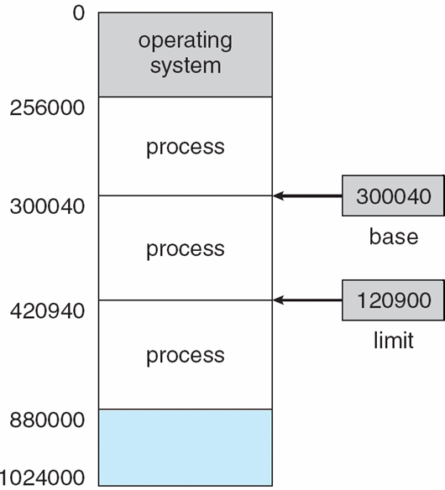
Base and Limit Registers
A pair of base and limit registers define the logical address space

Slide 6
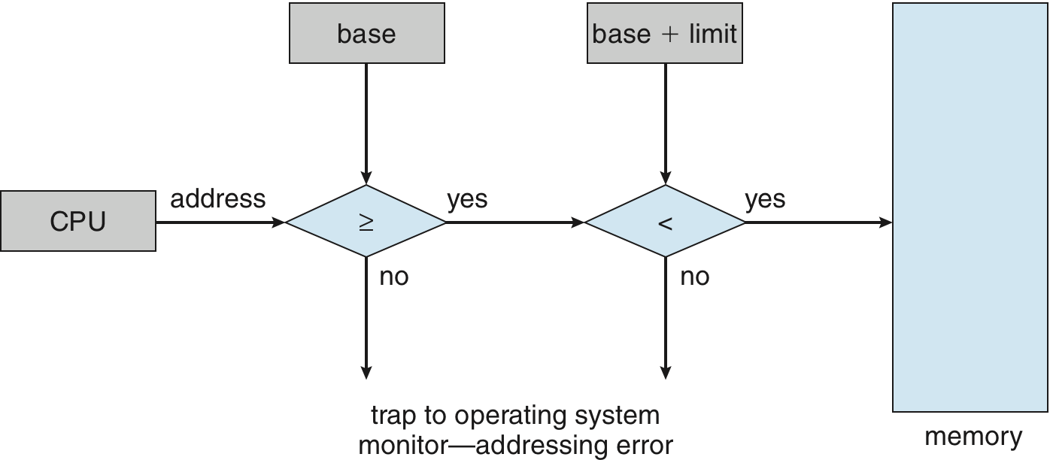
Hardware Address Protection with Base and Limit Registers

Slide 7
Address Binding
Most system allow a user process to reside in any part of the physical memory
Inconvenient to have first user process physical address always at 0000
Further, addresses represented in different ways at different stages of a program’s life
Source code addresses usually symbolic
Compiled code addresses bind to relocatable addresses
i.e. “14 bytes from beginning of this module”
Linker or loader will bind relocatable addresses to absolute addresses
i.e. 74014
Each binding maps one address space to another

Slide 8
Binding of Instructions and Data to Memory
Address binding of instructions and data to memory addresses can done at three different stages
Compile time: If memory location known a priori, absolute code can be generated; must recompile code if starting location changes
Load time: Must generate relocatable code if memory location is not known at compile time
Execution time: Binding delayed until run time if the process can be moved during its execution from one memory segment to another
Need hardware support for address maps

Slide 9
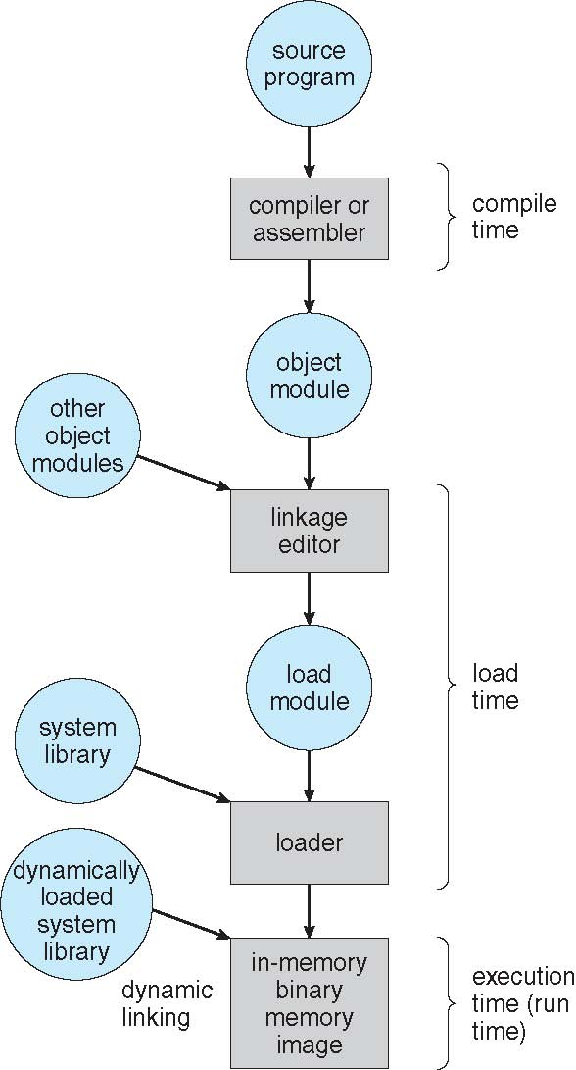
Multistep Processing of a User Program

Slide 10
Logical vs. Physical Address Space
The concept of a logical address space that is bound to a separate physical address space is central to proper memory management
Logical address – generated by the CPU; also referred to as virtual address
Physical address – address seen by the memory unit
Logical and physical addresses are the same in compile-time and load-time address-binding schemes; logical (virtual) and physical addresses differ in execution-time address-binding scheme
Logical address space is the set of all logical addresses generated by a program
Physical address space is the set of all physical addresses corresponding to the logical addresses

Slide 11
Memory-Management Unit (MMU)
Hardware device that at run time maps virtual to physical address
Many methods possible, covered in the rest of this chapter
To start, consider simple scheme where the value in the relocation register is added to every address generated by a user process at the time it is sent to memory
Base register now called relocation register
MS-DOS on Intel 80x86 used 4 relocation registers
The user program deals with logical addresses; it never sees the real physical addresses
Execution-time binding occurs when reference is made to location in memory

Slide 12
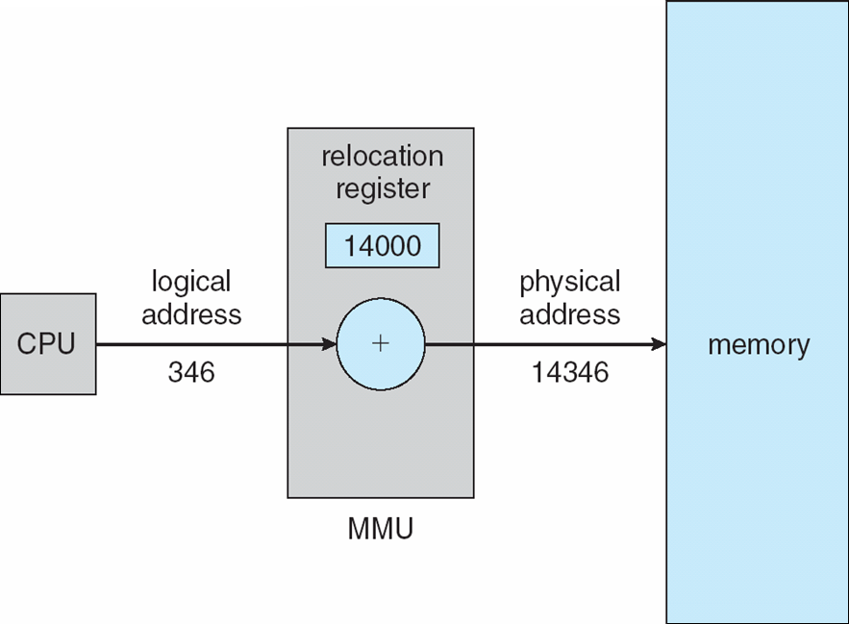
Dynamic relocation using a relocation register

Slide 13
Dynamic Loading
Routine is not loaded until it is called
Better memory-space utilization; unused routine is never loaded
All routines kept on disk in relocatable load format
Useful when large amounts of code are needed to handle infrequently occurring cases
No special support from the operating system is required
Implemented through program design
OS can help by providing libraries to implement dynamic loading

Slide 14
Dynamic Linking
Static linking – system libraries and program code combined by the loader into the binary program image
Dynamic linking –linking postponed until execution time
Small piece of code, stub, used to locate the appropriate memory-resident library routine
Stub replaces itself with the address of the routine, and executes the routine
Operating system checks if routine is in processes’ memory address
If not in address space, add to address space
System also known as shared libraries

Slide 15
Swapping
Total physical memory space of processes can exceed physical memory
Backing store – fast disk large enough to accommodate copies of all memory images for all users; must provide direct access to these memory images
Roll out, roll in – swapping variant used for priority-based scheduling algorithms; lower-priority process is swapped out so higher-priority process can be loaded and executed
Major part of swap time is transfer time; total transfer time is directly proportional to the amount of memory swapped
System maintains a ready queue of ready-to-run processes which have memory images on disk
Does the swapped out process need to swap back in to same physical addresses?
Depends on address binding method
Plus consider pending I/O to / from process memory space
Modified versions of swapping are found on many systems (i.e., UNIX, Linux, and Windows)
Swapping normally disabled
Started if more than threshold amount of memory allocated
Disabled again once memory demand reduced below threshold

Slide 16
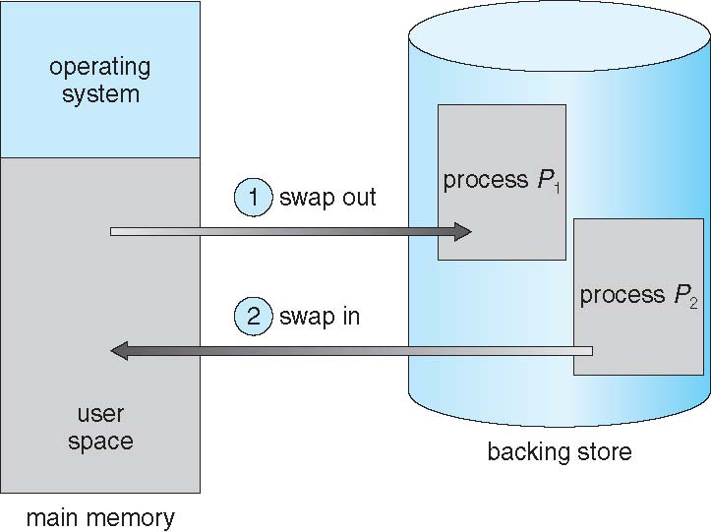
Schematic View of Swapping

Slide 17
Context Switch Time including Swapping
If next processes to be put on CPU is not in memory, need to swap out a process and swap in target process
Context switch time can then be very high
100MB process swapping to hard disk with transfer rate of 50MB/sec
Plus disk latency of 8 ms
Swap out time of 2008 ms
Plus swap in of same sized process
Total context switch swapping component time of 4016ms (> 4 seconds)

Slide 18
Contiguous Allocation
Main memory usually is divided into two partitions:
Resident operating system, usually held in low memory with interrupt vector
User processes then held in high memory
Each process contained in single contiguous section of memory
Relocation registers used to protect user processes from each other, and from changing operating-system code and data
Base register contains value of smallest physical address
Limit register contains range of logical addresses – each logical address must be less than the limit register
MMU maps logical address dynamically

Slide 19
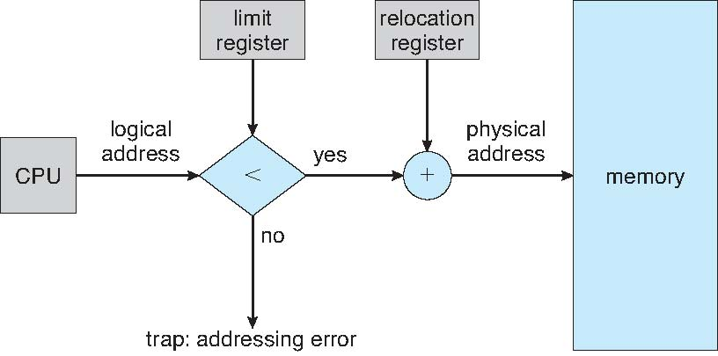
Hardware Support for Relocation and Limit Registers

Slide 20
Contiguous Allocation (Cont.)
Multiple-partition allocation
Degree of multiprogramming limited by number of partitions
Hole – block of available memory; holes of various size are scattered throughout memory
When a process arrives, it is allocated memory from a hole large enough to accommodate it
Process exiting frees its partition, adjacent free partitions combined
Operating system maintains information about: a) allocated partitions b) free partitions (hole)
OS
OS
OS
OS
process 5
process 5
process 5
process 5
process 9
process 9
process 8
process 10
process 2
process 2
process 2
process 2

Slide 21
Dynamic Storage-Allocation Problem
How to satisfy a request of size n from a list of free holes?
First-fit: Allocate the first hole that is big enough
Best-fit: Allocate the smallest hole that is big enough; must search entire list, unless ordered by size
Produces the smallest leftover hole
Worst-fit: Allocate the largest hole; must also search entire list
Produces the largest leftover hole
First-fit and best-fit better than worst-fit in terms of speed and storage utilization

Slide 22
Fragmentation
External Fragmentation – total memory space exists to satisfy a request, but it is not contiguous
Internal Fragmentation – allocated memory may be slightly larger than requested memory; this size difference is memory internal to a partition, but not being used
First fit analysis reveals that given N blocks allocated, next 0.5 N blocks lost to fragmentation
1/3 may be unusable -> 50-percent rule

Slide 23
Fragmentation (Cont.)
Reduce external fragmentation by compaction
Shuffle memory contents to place all free memory together in one large block
Compaction is possible only if relocation is dynamic, and is done at execution time
I/O problem
Latch job in memory while it is involved in I/O
Another possible solution to the external fragmentation problem is to permit the logical address space of the processes to be noncontiguous

Slide 24
Paging
Physical address space of a process can be noncontiguous; process is allocated physical memory whenever the latter is available
Divide physical memory into fixed-sized blocks called frames
Size is power of 2, between 512 bytes and 16 Mbytes
Divide logical memory into blocks of same size called pages
Keep track of all free frames
To run a program of size N pages, need to find N free frames and load program
Set up a page table to translate logical to physical addresses
Still have Internal fragmentation

Slide 25
Address Translation Scheme
Address generated by CPU is divided into:
Page number (p) – used as an index into a page table which contains base address of each page in physical memory
Page offset (d) – combined with base address to define the physical memory address that is sent to the memory unit
For given logical address space 2^{m} and page size 2^{n}
page number
page offset
p
d
m - n
n

Slide 26
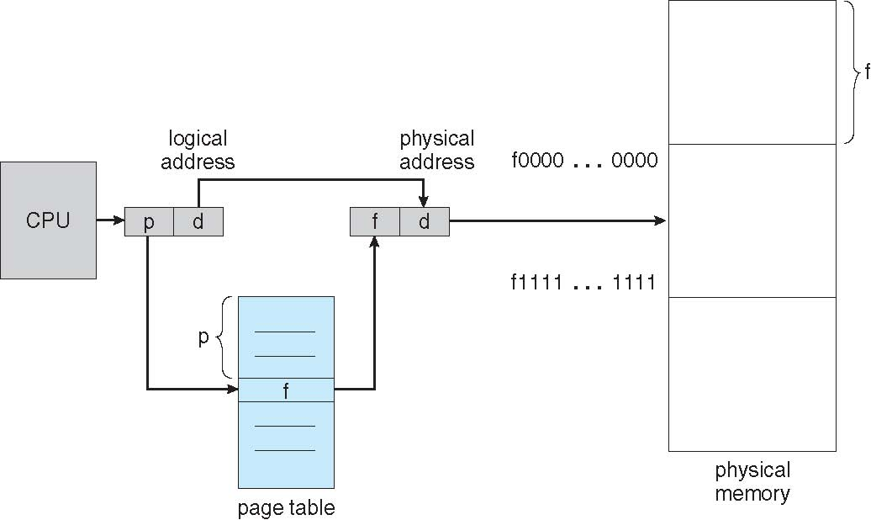
Paging Hardware

Slide 27
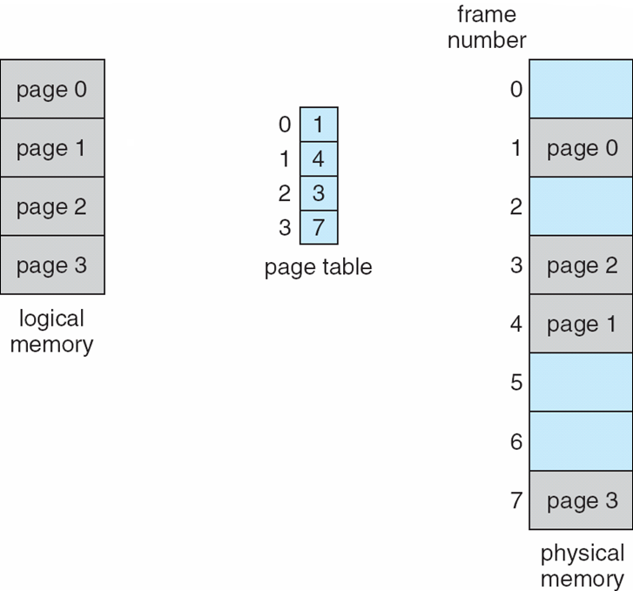
Paging Model of Logical and Physical Memory

Slide 28
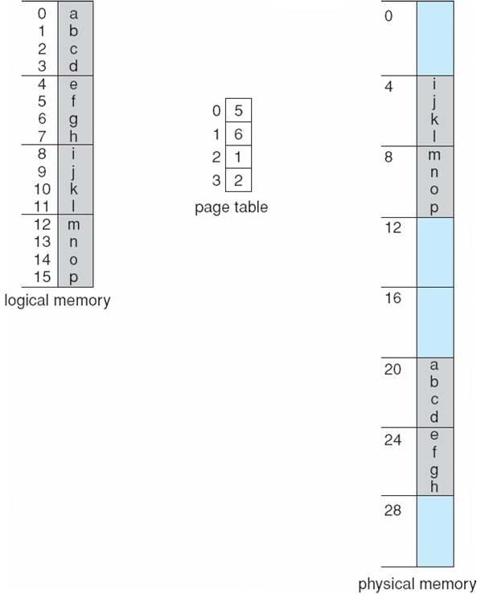
Paging Example
n=2 and m=4 32-byte memory and 4-byte pages

Slide 29
Paging (Cont.)
Calculating internal fragmentation
Page size = 2,048 bytes
Process size = 72,766 bytes
35 pages + 1,086 bytes
Internal fragmentation of 2,048 - 1,086 = 962 bytes
Worst case fragmentation = 1 frame – 1 byte
On average fragmentation = 1 / 2 frame size
So small frame sizes desirable?
But each page table entry takes memory to track
Page sizes growing over time
Solaris supports two page sizes – 8 KB and 4 MB
Process view and physical memory now very different
By implementation process can only access its own memory

Slide 30
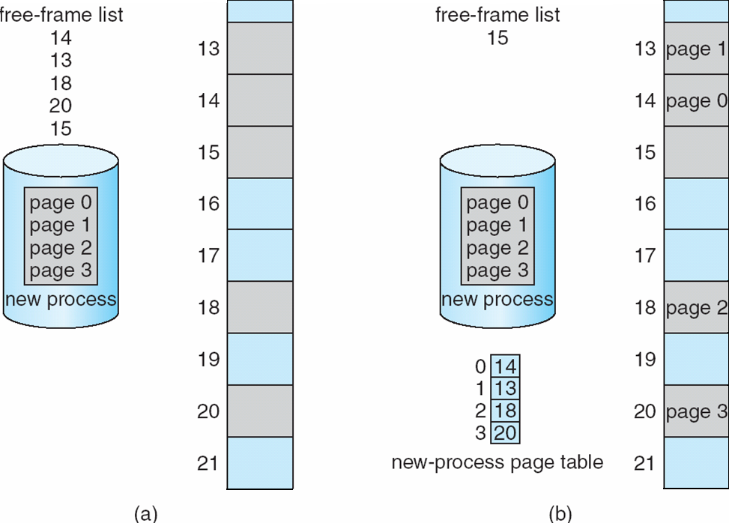
Free Frames
Before allocation
After allocation

Slide 31
Implementation of Page Table
Page table is kept in main memory
Page-table base register (PTBR) points to the page table
Page-table length register (PTLR) indicates size of the page table
In this scheme every data/instruction access requires two memory accesses
One for the page table and one for the data / instruction
The two memory access problem can be solved by the use of a special fast-lookup hardware cache called associative memory or translation look-aside buffers (TLBs)

Slide 32
Implementation of Page Table
Some translation look-aside buffers (TLBs) store address-space identifiers (ASIDs) in each TLB entry – uniquely identifies each process to provide address-space protection for that process
TLBs typically small (64 to 1,024 entries)
On a TLB miss, value is loaded into the TLB for faster access next time
Replacement policies must be considered
Some entries can be wired down for permanent fast access

Slide 33
Associative Memory
Associative memory – parallel search
Address translation (p, d)
If p is in associative register, get frame # out
Otherwise get frame # from page table in memory
Page #
Frame #

Slide 34
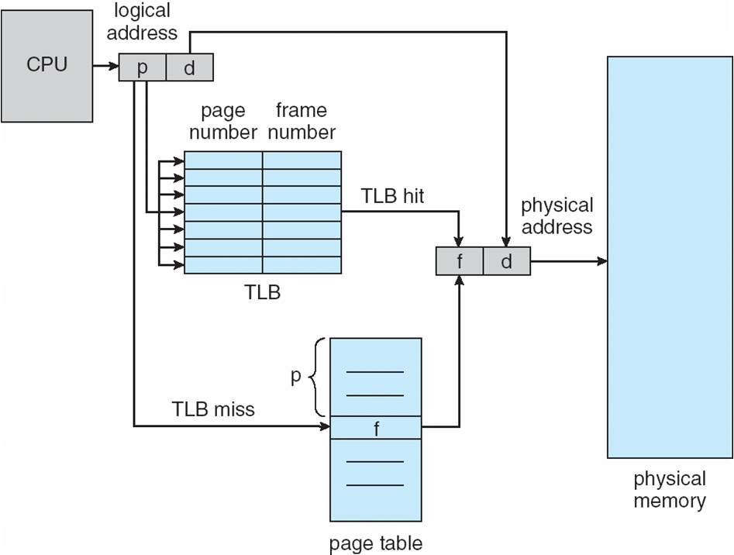
Paging Hardware With TLB

Slide 35
Effective Access Time
Associative Lookup = ε time unit
Can be < 10% of memory access time
Hit ratio = α
Hit ratio – percentage of times that a page number is found in the associative registers; ratio related to number of associative registers
Consider α = 80%, ε = 20ns for TLB search, MA=100ns for memory access
Effective Access Time (EAT)
EAT = (MA + ε) α + (2MA + ε)(1 – α) = 2MA + ε – MAα
Consider α = 80%, ε = 20ns for TLB search, 100ns for memory access
EAT = 0.80 x 120 + 0.20 x 220 = 140ns
Consider slower memory but better hit ratio -> α = 98%, ε = 20ns for TLB search, 140ns for memory access
EAT = 0.98 x 160 + 0.02 x 300 = 162.8ns

Slide 36
Questions
If access memory reference takes 150 nanoseconds, how long does a paged memory reference take?
If we add TLBs, and 55 percent of all page table references are found in the TLBs what is effective memory reference time? (Assume that finding a page table entry in the TLBs takes 5 nanoseconds)

Slide 37
End of Chapter 7 (Part 1)

